Slide 1

Stock Market Vs. Unemployment
The Correlation Coalition
Michael Themistocleous, Robert Simeonoglou, Shilpa Gonella, Rusen Bicer

Slide 2
Table of Contents
Overview
Goals
Pre-Analysis Questions
Sources
Data Cleanup & Exploration
Data Analysis
Discussion
Questions?

Slide 3

Overview:
HypothesiS
The Economy vs Unemployment
Why did we choose this topic?
Real World Implications
Current News with COVID-19

Slide 4
Goals :
National unemployment rate vs Stock Market
Utilize Historical data
State-level unemployment rate vs Stock Market
Are certain areas of the US affected more than others?
Findings Overview :
Higher correlation over the years
As the stock market has grown, so has the correlation

Slide 5

Pre-Analysis Questions:
What market index will we be using?
How will we find unemployment data?
How many years of data do we need?
How will we manipulate the data found to meet our needs?
What sort of analysis will we be performing?
What type of visual data will we use?

Slide 6




Sources
Dow Jones Industrial Average Stock Prices – Kaggle.com
US Bureau of Labor Statistics Unemployment Rate API – USA
US Bureau of Labor Statistics Unemployment Rate API – per State
Google Gmaps

Slide 7



Data Cleanup & Exploration

Slide 8
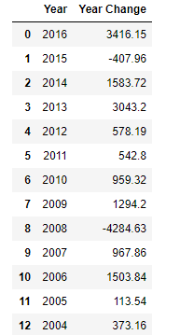
Dow Jones
Understanding the information
Data Given:
Weekly breakdown by Date and Value
Cleanup Process
Separate Month, Day, Year, and Value
Remove Day and sort years as descending values/concatenate
Take only the first value for every month
Find the Yearly Change and only choose January Values
Questions:
Why did we break it down by months and years?
Final Result:
(Before Index Drop)

Slide 9

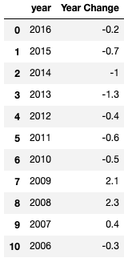
US Bureau of Labor Statistics Unemployment(Country-Wide)
Understanding the information
Data Retrieval
Find the correct data “series”
Read documentation
Use a ”post” method instead of a “get”
Data Given
Unemployment percentage per month
Cleanup Process
Required the percent change over each year
Iterate through rows of dataframe to find change
Final Result:

Slide 10
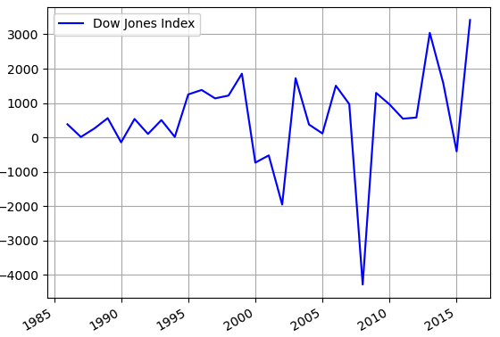
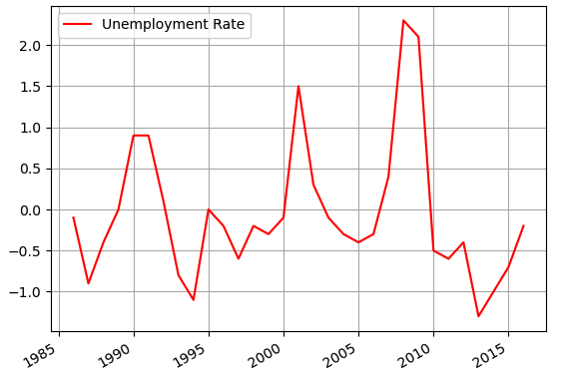
Dow Jones
Yearly Change Breakdown
Bureau of Labor Statistics
Index Price vs. Year
Unemployment Change Rate vs. Year

Slide 11
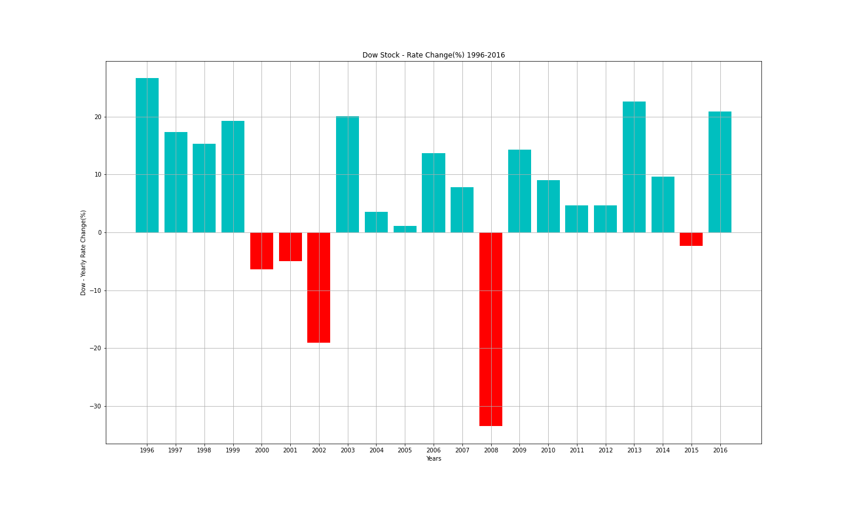
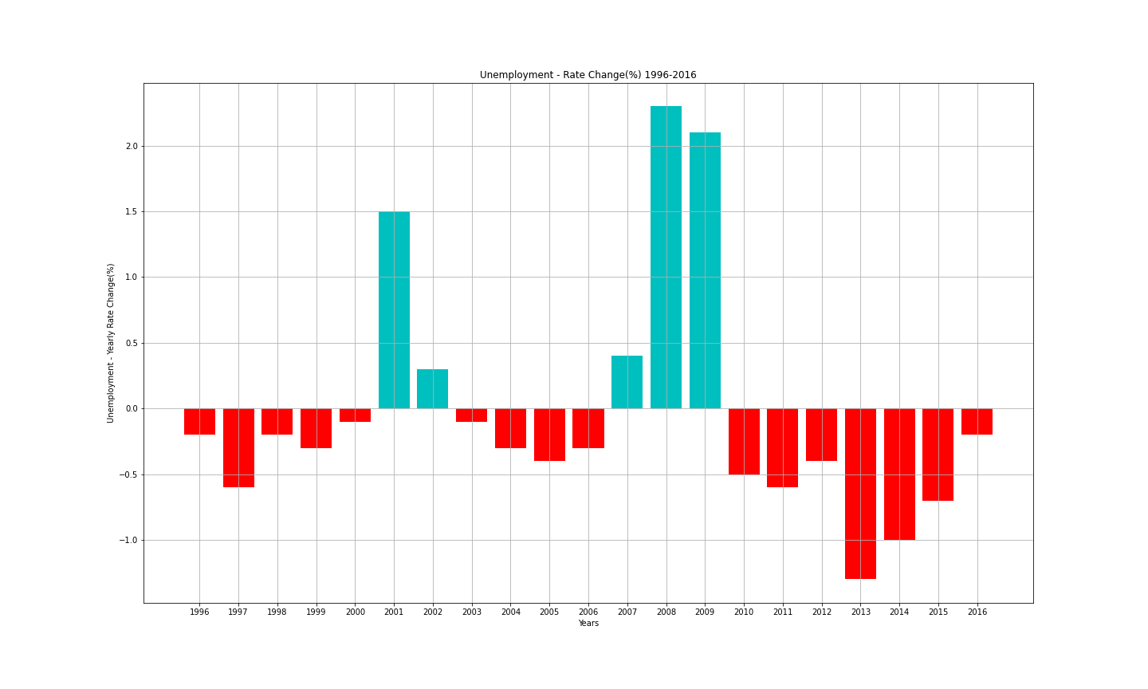
Dow Jones
Yearly Rate Change Breakdown
(1996-2016)
Bureau of Labor Statistics
Index Rate Change vs. Year
Unemployment Change Rate vs. Year

Slide 12
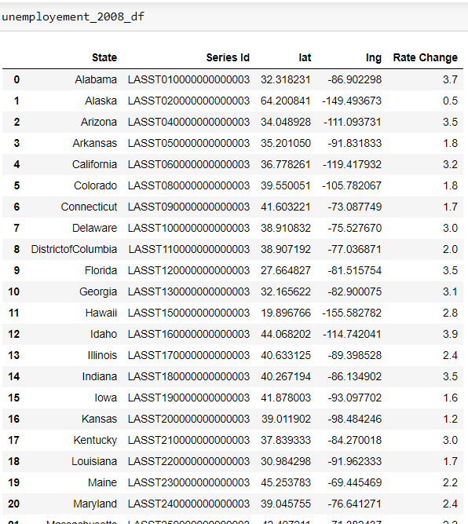
US Bureau of Labor Statistics Unemployment(State-Specific)
Final Result:
Understanding the information
Data Retrieval
Used state & Category specific data “series”
Collected list of all states
Data Given
Unemployment percentage per month
Cleanup Process
Required the percent change month over month for 2008
Iterate through rows of dataframe to find change

Slide 13
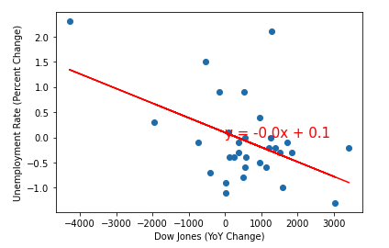
Data Analysis
Correlation Analysis – National Unemployment Rate vs Dow Jones Index
30 years (1986-2016)
R-value equals -0.48
Moderate negative relationship

Slide 14
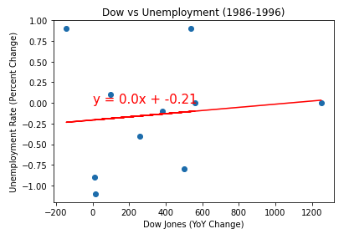
Data Analysis – 1986 to 1996
10 years (1986-1996)
R-value equals 0.11
Almost no linear relationship

Slide 15
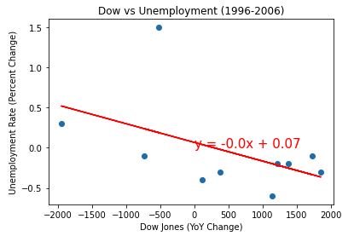
Data Analysis – 1996 to 2006
10 years (1996-2006)
R-value equals -0.49
Moderate negative relationship

Slide 16
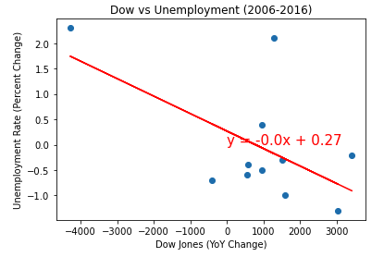
Data Analysis – 2006 to 2016
10 years (2006-2016)
R-value equals -0.59
Moderate negative relationship
Slightly stronger than the previous 10 years
Each set of years has increased in correlation

Slide 17
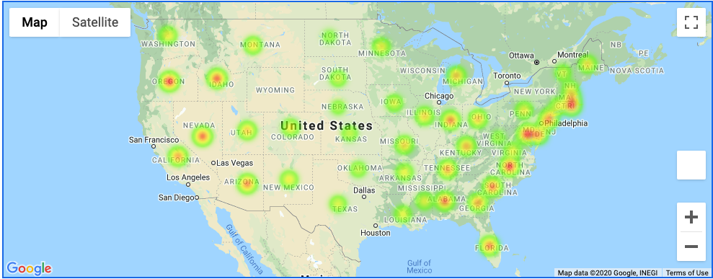
Data Analysis – State Level
Chose the year with the max negative relationship - 2008
Graphed using Google Maps
Used a heat layer to show intensity of unemployment across the United States
Metro Areas vs Rural America

Slide 18
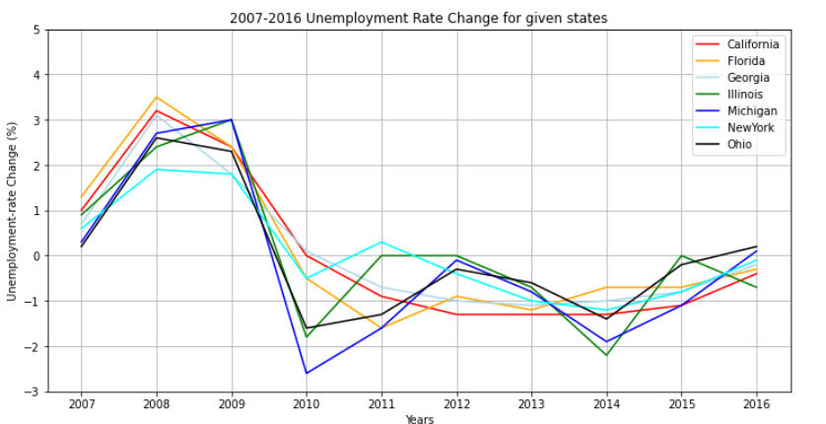
Data Analysis – State Level
Plotting Unemployment Rate Change comparison for metro areas through years (2007-2016)

Slide 19
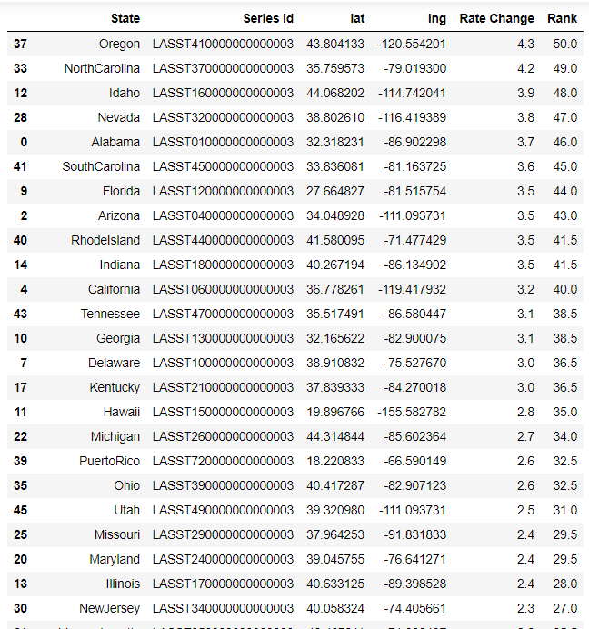
Data Analysis – State Level
Our thoughts were that big metro-areas such as New York and California would have been more affected, but that does not seem to be the case

Slide 20

Discussion
Findings:
Overall we found what we expected, but not to the degree we had thought
Most interesting to find the continuous increase in relationship over time
Found that the most affected states didn’t seem to be large metro areas
Post Mortem
Was Dow Jones the correct index to use?
S&P 500
Other factors that overlay?
GDP
Inflation
How much do external events affect the Dow/Unemployment?
Were certain industries affected more than others? Could that skew State data?
2020 Analysis – Would Covid-19 scenario go against previous years?

Slide 21

Questions?

